Slide 1
Head Up Tilt table test

Slide 2
SYNCOPE - Definition
Transient Loss of consciousness (LOC)
Loss of postural tone
Quick recovery
No neurological complication
Mechanism of LOC : Decrease in blood supply to brain

Slide 3
TYPES OF SYNCOPE
Cardiogenic syncope
Vascular causes
- orthostatic hypotension
- neurally mediated syncope
(vasovagal)

Slide 4
Physiology
Blood circulation controlled by
Sympathetic nerves - increase HR,BP
Parasympathetic nerves -decrease HR,BP

Slide 5
Physiology
Venous pooling of blood
Decreased blood volume to heart chambers
Sensed by receptors
Increases sympathetic activity to increase HR,BP
But in some persons, there is overactivity of parasympathetic system -fall in BP and HR -Syncope

Slide 6
Cardiac syncope
Arrhythmias -tachy,brady
Aortic stenosis
HOCM
Pulmonary embolism
LA myxoma

Slide 7
Neurally mediated syncope
Also called vasovagal syncope
No structural abnormalities
Precipitated by prolonged standing,emotion,exertion

Slide 8
In some persons this is associated with severe fall in heart rate and BP, that lead to frequent syncope

Slide 9
Initial evaluation of syncope
Differentiate it from seizure
Rule out cardiac causes
Appropriate cardiac investigations
If no cause could be found and ECG is normal,suspected neurally mediated syncope

Slide 10
A tilt table test is used to evaluate the cause of unexplained fainting
.

Slide 11
Contraindications
Severe anemia
Recent stroke (within seven days)
Recent myocardial infarction
Severe proximal cerebral or coronary arterial disease
Critical mitral or aortic stenosis
Left ventricular outflow tract obstruction
Tachyarrhythmias
End-stage renal failure
Severe heart failure

Slide 12
Preparation
Fasting for 2 hrs
No diabetic medications
Informed consent

Slide 13
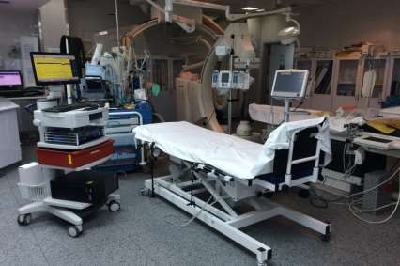
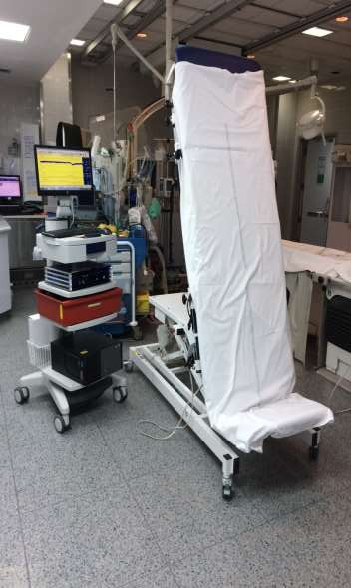
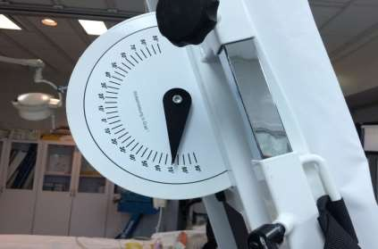

Slide 14
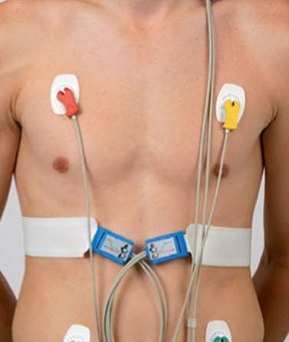
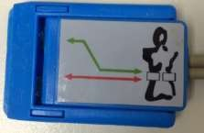
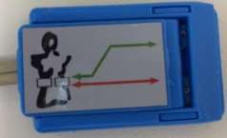
Electrodes
Place two of the three ICG electrodes at the lateral side at xiphoid-level.

Slide 15
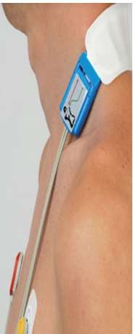
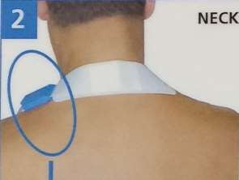
Neck electrode
Place the third electrode on the neck between hair line and shoulder.
.
.

Slide 16
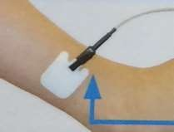
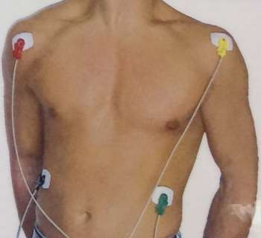
Place the neutral electrode on the left leg or hip.
The ECG electrodes are placed as usual to get a high resolution ECG.

Slide 17
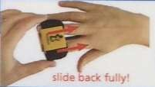
Finger cuff
Choose the appropriate finger cuff out of the sizes small, medium and large.
The cuff should not be too tight or too loose as this influences the signal quality.
Place the finger cuff on two fingers.

Slide 18
Upper arm BP cuff
Select the upper arm cuff according to the circumference of the patient’s upper arm.
small adult=17-25cm,adult=23-33cm large adult=31-40cm.
.

Slide 19
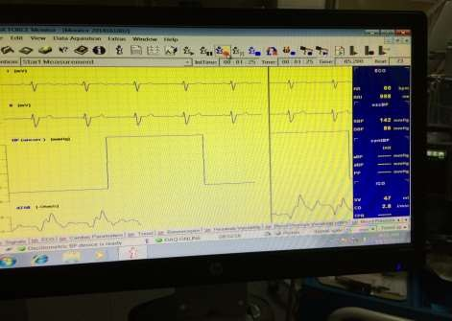
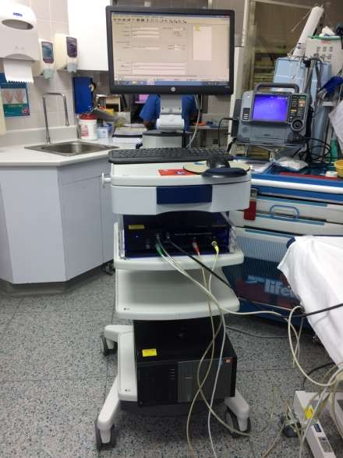

Slide 20
STAGES OF THE TEST
STAGE 1 - SUPINE FOR 5 MINS
STAGE 2 -AT 70 DEGREE TILT UP FOR 20 MIN
STAGE 3 -PHARMACOLOGICAL PROVOCATION FOR 20 MIN

Slide 21
Medication used during the test
Nitroglycerine → venous pooling, ↓volume.
↑sympathetic and ↑HR then syncope episode occurs .
Isoprenaline → ↑HR+↑BP and then a reflex ↑ in parasympathetic.

Slide 22
WHEN TO STOP
When symptoms appear
Very progressive BP FALL for more than 5 min
No symptoms at end of 45 min

Slide 23
Test is postive if
Symptoms occur
Fall in BP or HR

Slide 24
CLASSIFICATION OF POSITIVE RESPONSES
Cardio inhibitory
Vaso depressor
Mixed

Slide 25
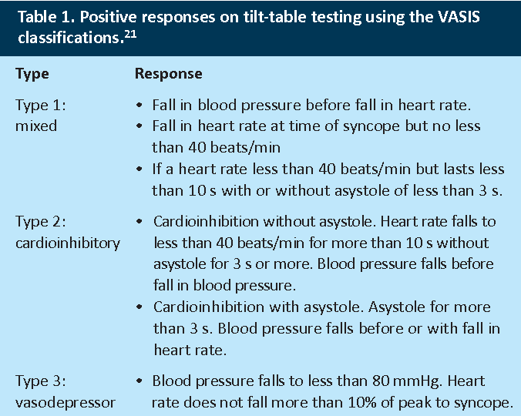

Slide 26
Complications
If test Is positive. Lower the table immediately Keep the legs up
Replace IV fluids
If severe Brady then injection atropine.

Slide 27
Management
Salt intake
Tilt training
Physical counter pressure
Drugs
Pacemaker DDD

Slide 28
Summary
Types of syncope
Indication of TTT
Lead placement and maneuvering
Stages of the test
Interpretation
Management

